Slide 1


Introduction to Deep Learning in Social Sciences Fundamentals
Dr Maria Prokofieva

Slide 2
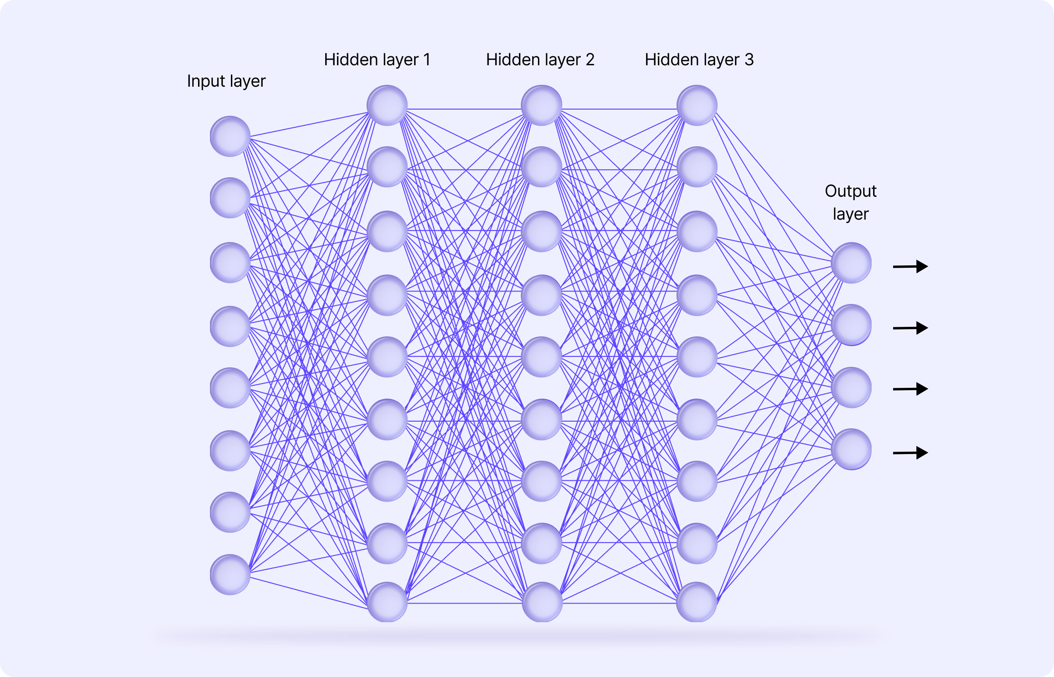
Deep learning (DL)
Deep learning = a type of machine learning that uses neural networks with many layers to automatically learn patterns from data.
Unlike traditional ML, where humans design features, DL learns features and predictions end-to-end.
It thrives on large datasets and high compute.

Slide 3
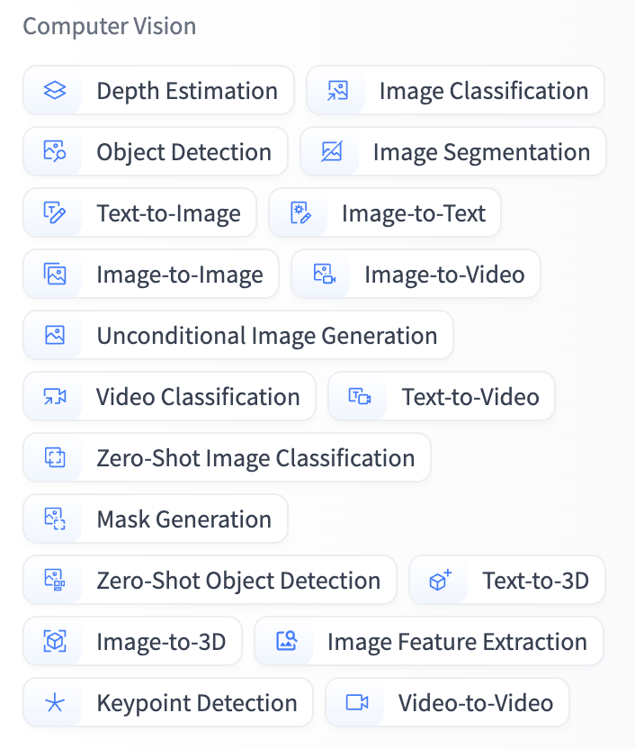
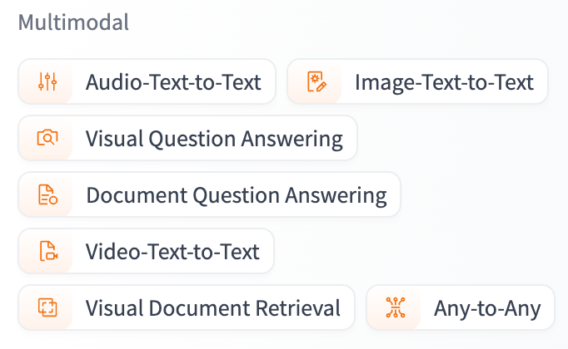
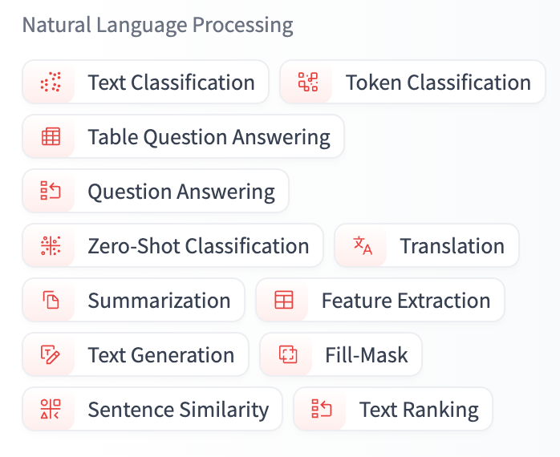
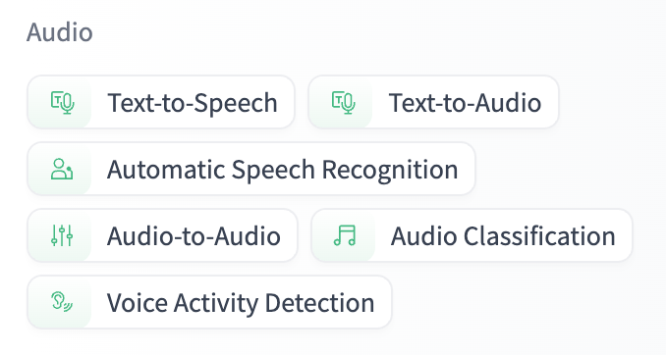
DL Tasks

Slide 4
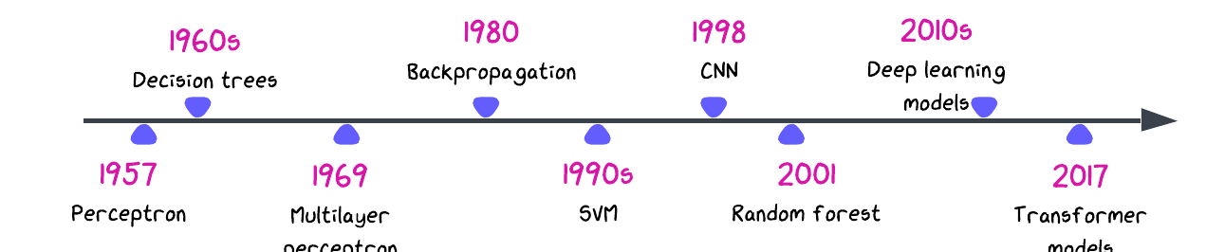
Evolution of Deep Learning

Slide 5
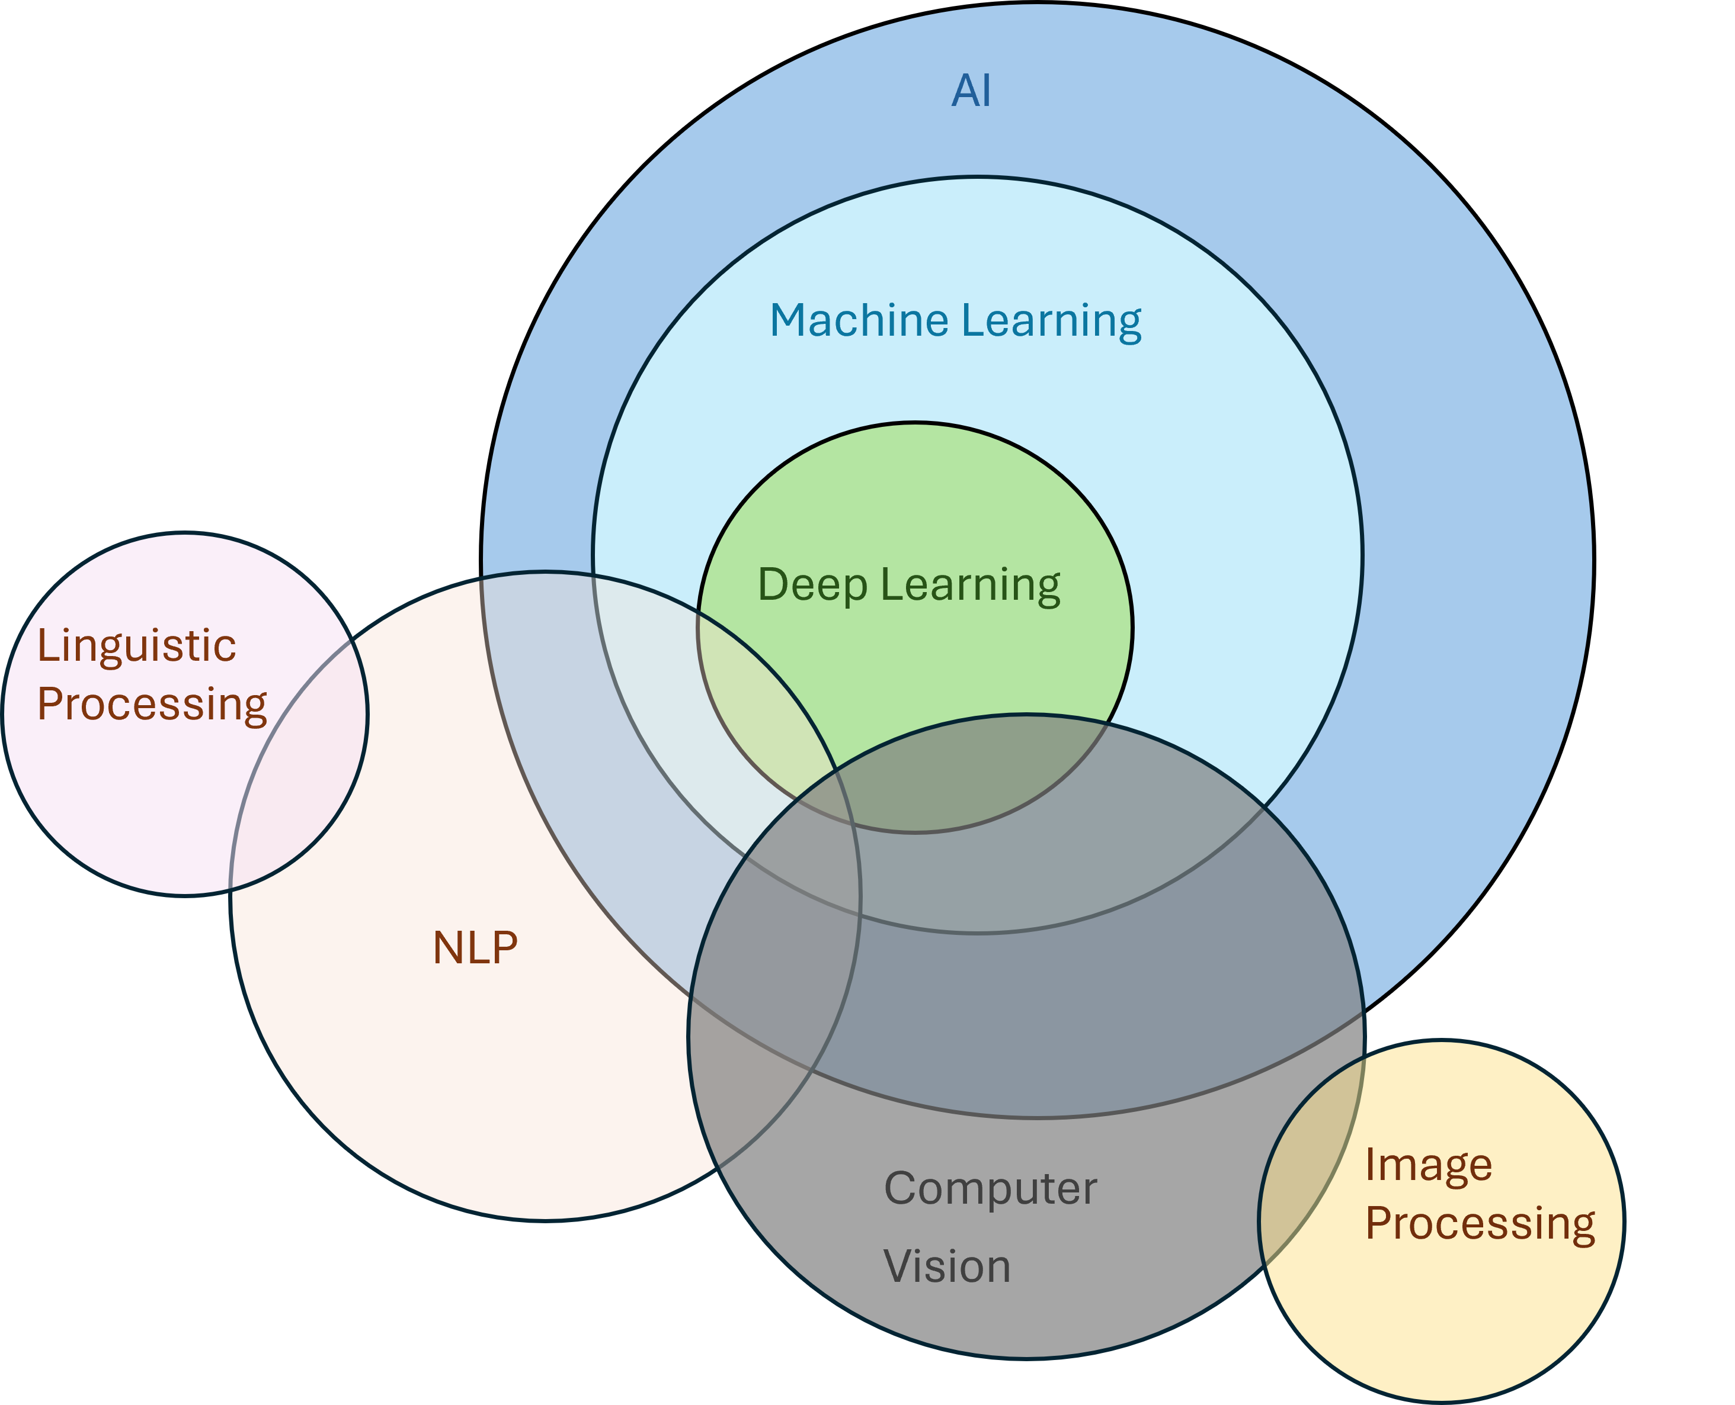
Machine Learning vs Deep Learning
DL is an evolution of ML
ML = handcrafted features + classical algorithms (SVM, decision trees, etc.).
DL = feature learning + neural networks (end-to-end).

Slide 6

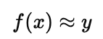
Modeling
Modeling is at the heart of Machine Learning/DL
The aim of modeling is to make predictions or decisions from data:
i.e. approximate the relationship between inputs and outputs
A model is a mathematical function:
x = input (image, text, audio, tabular data).
y = target (label, category, numerical value).
Models generalize:
given new, unseen data, the model should make accurate predictions without human intervention

Slide 7
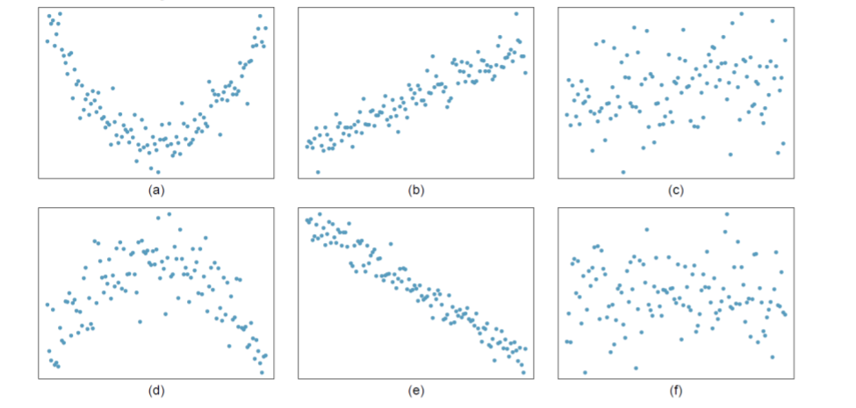
Data
A model cannot “invent knowledge”; it learns patterns from data.
Data provides examples of the world.
Each training example is a pair (x, y) showing what the correct output should be.
By learning from many examples, the model “discovers” the underlying patterns.
Modeling is at the heart of ML → everything else (data prep, training, evaluation, deployment) revolves around building, refining, and testing models.
Notes:
Each data point is an example of the world.
If we show enough examples, the model can approximate the relationship between input and output.

Slide 8
Data and Labels
Most of the time, we want a model that predicts a specific output (y) from input X
For this, we need labeled data — examples with answers.
If you want a model that outputs specific answers (cat vs dog, tumor vs healthy), you need examples with the answers included → labeled data.
Supervised learning
X
y

Slide 9
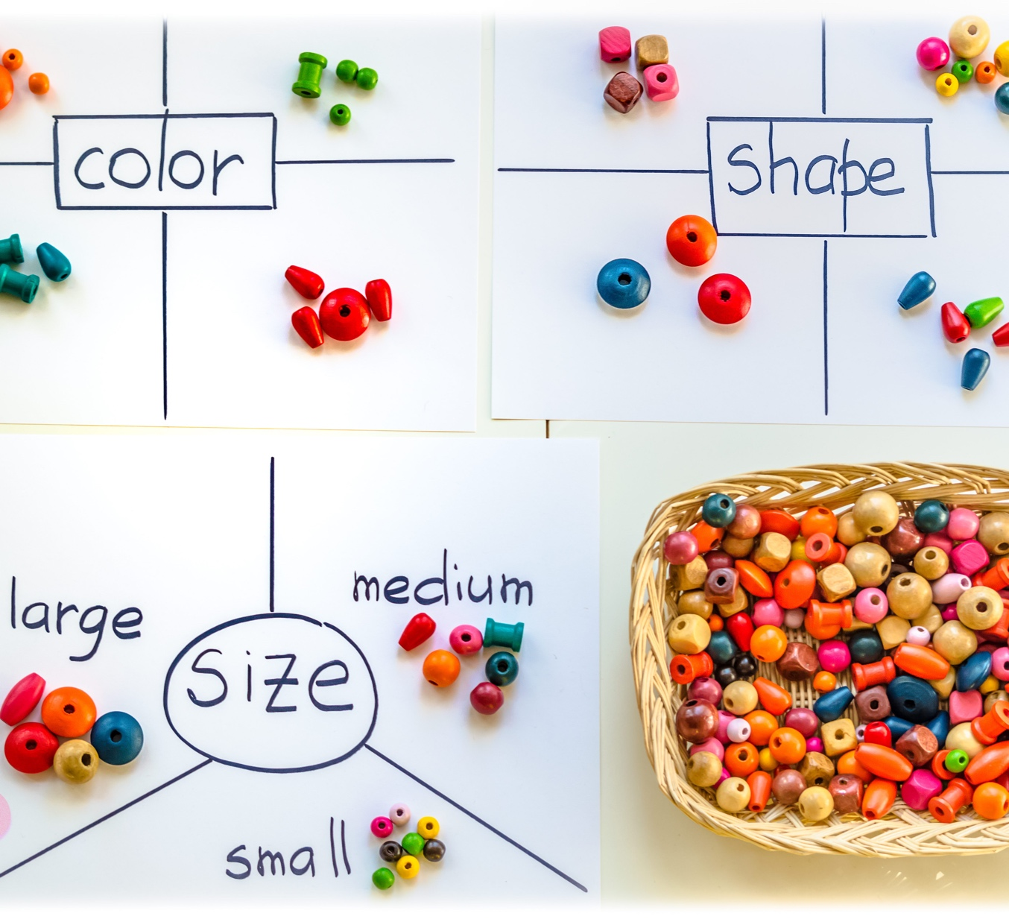
Data and No Labels?
Real world: unlabeled data is everywhere (images, audio, text)<- Labels are expensive to create.
The model can still find patterns, but not specific predictions → Unsupervised learning.
Notes:
Given thousands of unlabeled animal photos → model groups “similar looking” images (cats together, dogs together), but doesn’t assign names.
Imagine a student learning math:
Teacher gives problems with answers → student compares their attempt, corrects mistakes → supervised learning.
Teacher only gives raw problems with no answers → student groups similar problems together but can’t know the “truth” → unsupervised learning.
The aim in both cases: improve performance on new unseen problems.

Slide 10
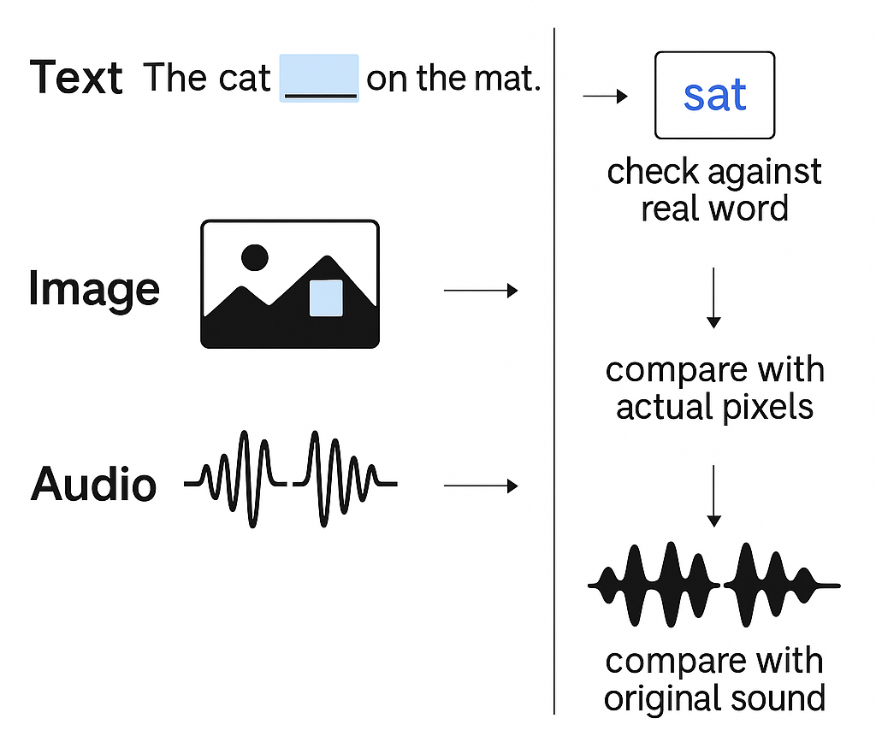
Self-Supervised Learning (SSL): The Middle Ground
Supervised: we need a teacher (labels) to tell the model if it’s right or wrong.
SSL: the model IS the teacher: it “hides” some data, predicts its and check the answer
Model is the teacher and the student
Notes:
How It Works
Take raw data.
Hide or mask part of it.
Ask the model to guess the missing part.
Compare the guess with the actual hidden part (ground truth).
If wrong → update model. If right → reinforce pattern.

Slide 11
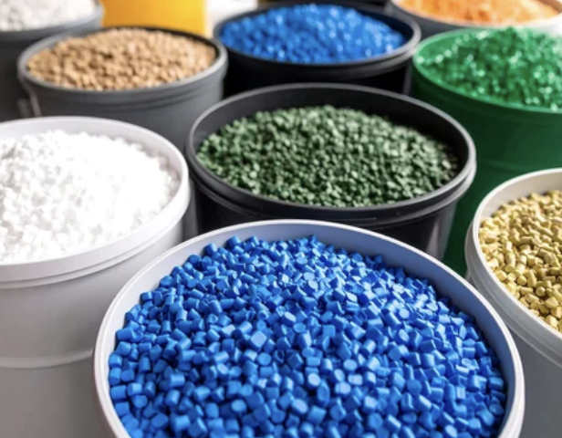
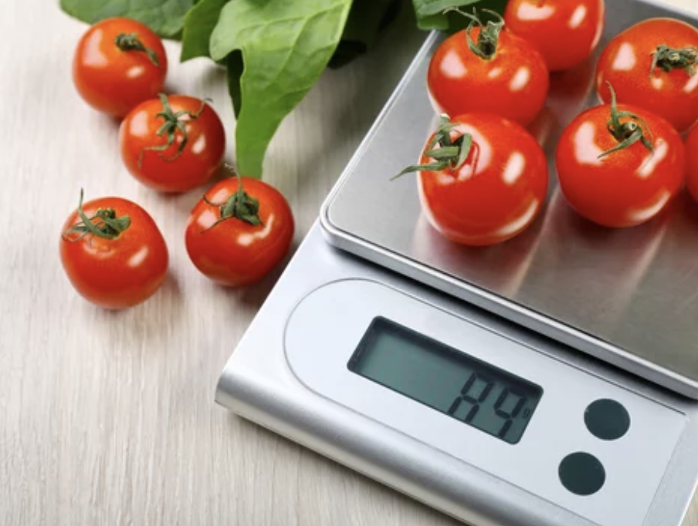
What do we want the model to predict?
We need to decide what “kind” of label (y) we want to get
Example:
Text → “Predict if the review is positive / negative”(classification).
Vision → “Predict the colour value in a missing photo patch?” (regression).

Slide 12

Data is Critical
Good data → useful patterns. Bad data → garbage predictions.
What makes data good?
Accurate labels (cat really is a cat).
Clean inputs (no corrupted images or noisy transcripts).
Representative samples (covers the real-world variation: lighting, accents, contexts).
Balanced classes (not 95% “cat” and 5% “dog”).
Notes:
Examples of poor quality:
Blurry scans mislabeled as “healthy.”
Speech transcripts with typos.
Reviews dataset with only positive examples.

Slide 13
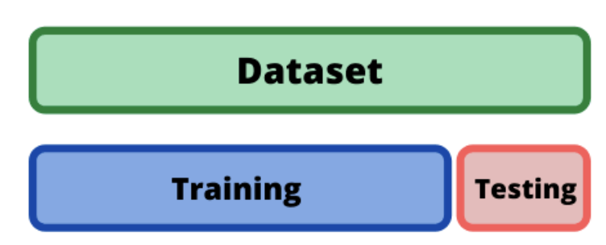
”Unseen” Data
Q: As the model learns from the data - how do we check that the patterns still hold on unseen data?
A: ”Hide away” some existing data and show it as ”unseen”
Model development:
Train = learning patterns.
Test = unseen → checks generalization.
Inference:
All new data: all learning patterns should be valid.

Slide 14
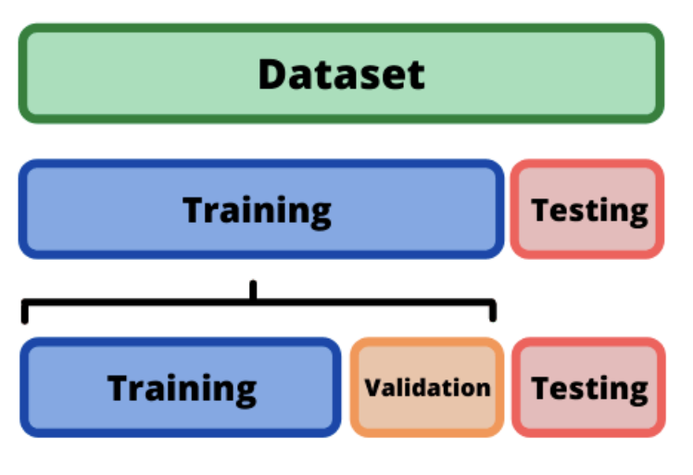
Validation data
A small slice of data kept aside from training.
Used to check how well the model is learning before the final test.
Helps us spot:
If the model is overfitting (memorizing training data).
Which version of a model works better.

Slide 15
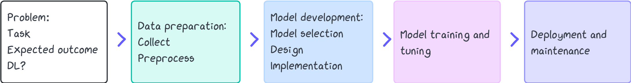
Putting this together
Model development:
Train = learning patterns.
Test = unseen → checks generalization.
Inference:
All new data
What happens inside the DL model training?

Slide 16
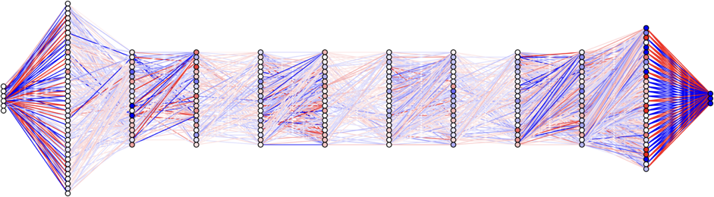
Neural Network Basics
A neural network is a stack of layers (simple mathematical functions).
Each layer transforms data step by step → from raw input to meaningful output.
What makes the model learn is the weights, which adjust to fit patterns in the data.
Notes:
Analogy: a pipeline of filters, each making the picture clearer.
Key point: what makes it learn is the weights, which adjust to fit patterns in the data.

Slide 17
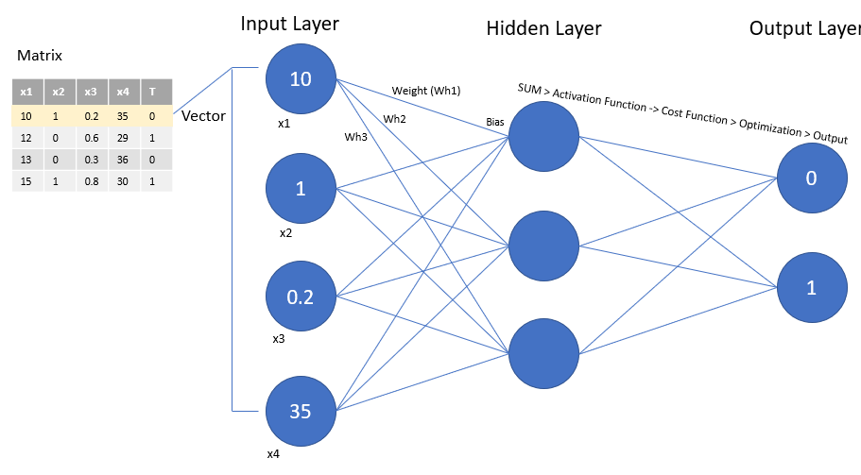
What Are Weights?
The weights ARE the model
Each connection between layers has a weight = strength of influence.
At first: random weights → random guesses.
During training: weights are adjusted to reduce error.
End result: the set of all weights = the trained knowledge of the model.

Slide 18
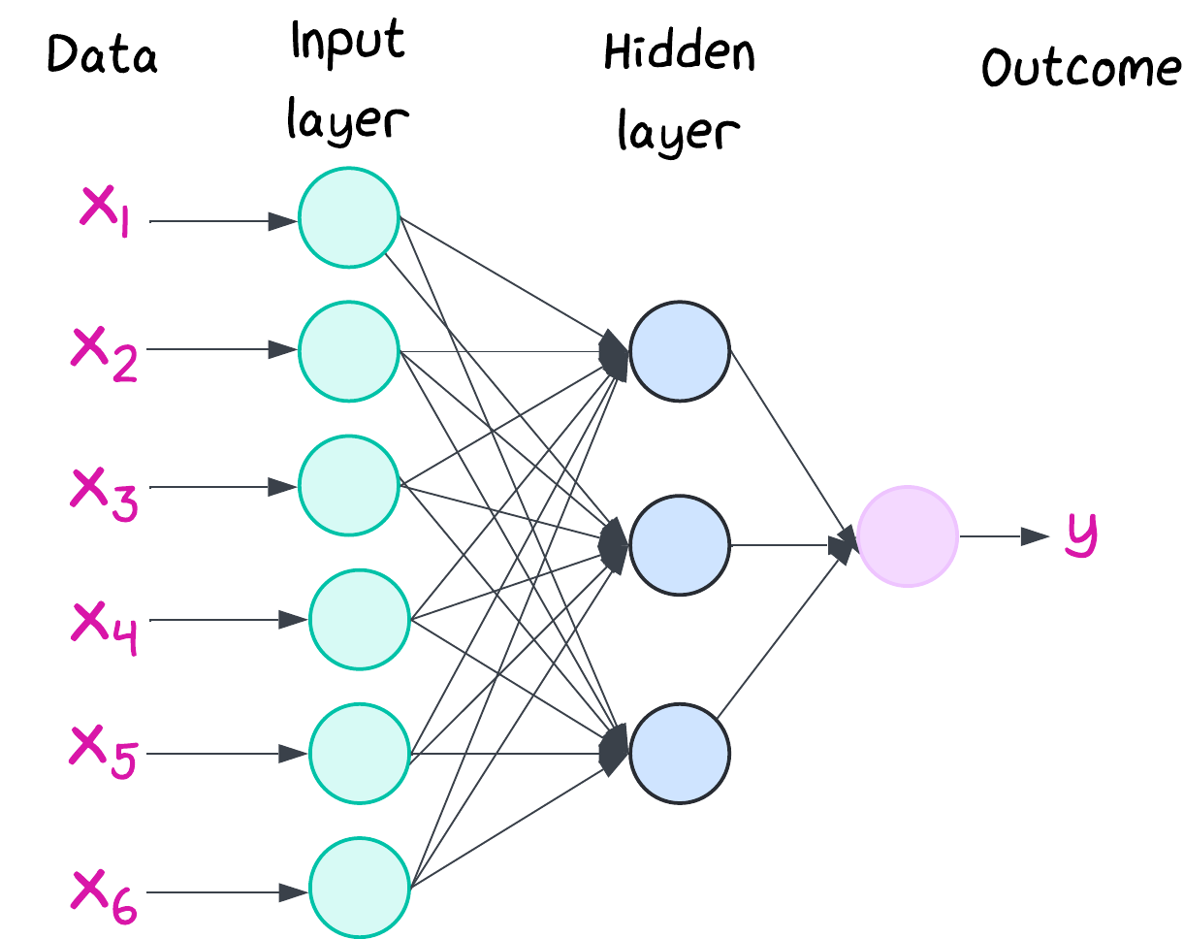
Layers and Representations
Input layer: raw data (pixels, waveforms, tokens).
Hidden layers: learned representations (edges → textures → objects in vision; characters → words → meaning in text).
Output layer: final prediction (class label, number, text token).
Hidden layers = the model’s internal language for “taking notes” about the data.

Slide 19

Parameters & Model Size
Parameters = all the learnable weights and biases in the model.
Model size is measured in number of parameters (e.g., 110M, 1B).
Bigger ≠ always better :
more parameters = more capacity but
more compute + more data needed.
Model cards report this so you can gauge complexity and hardware needs.
But how do these parameters actually get used and updated?

Slide 20
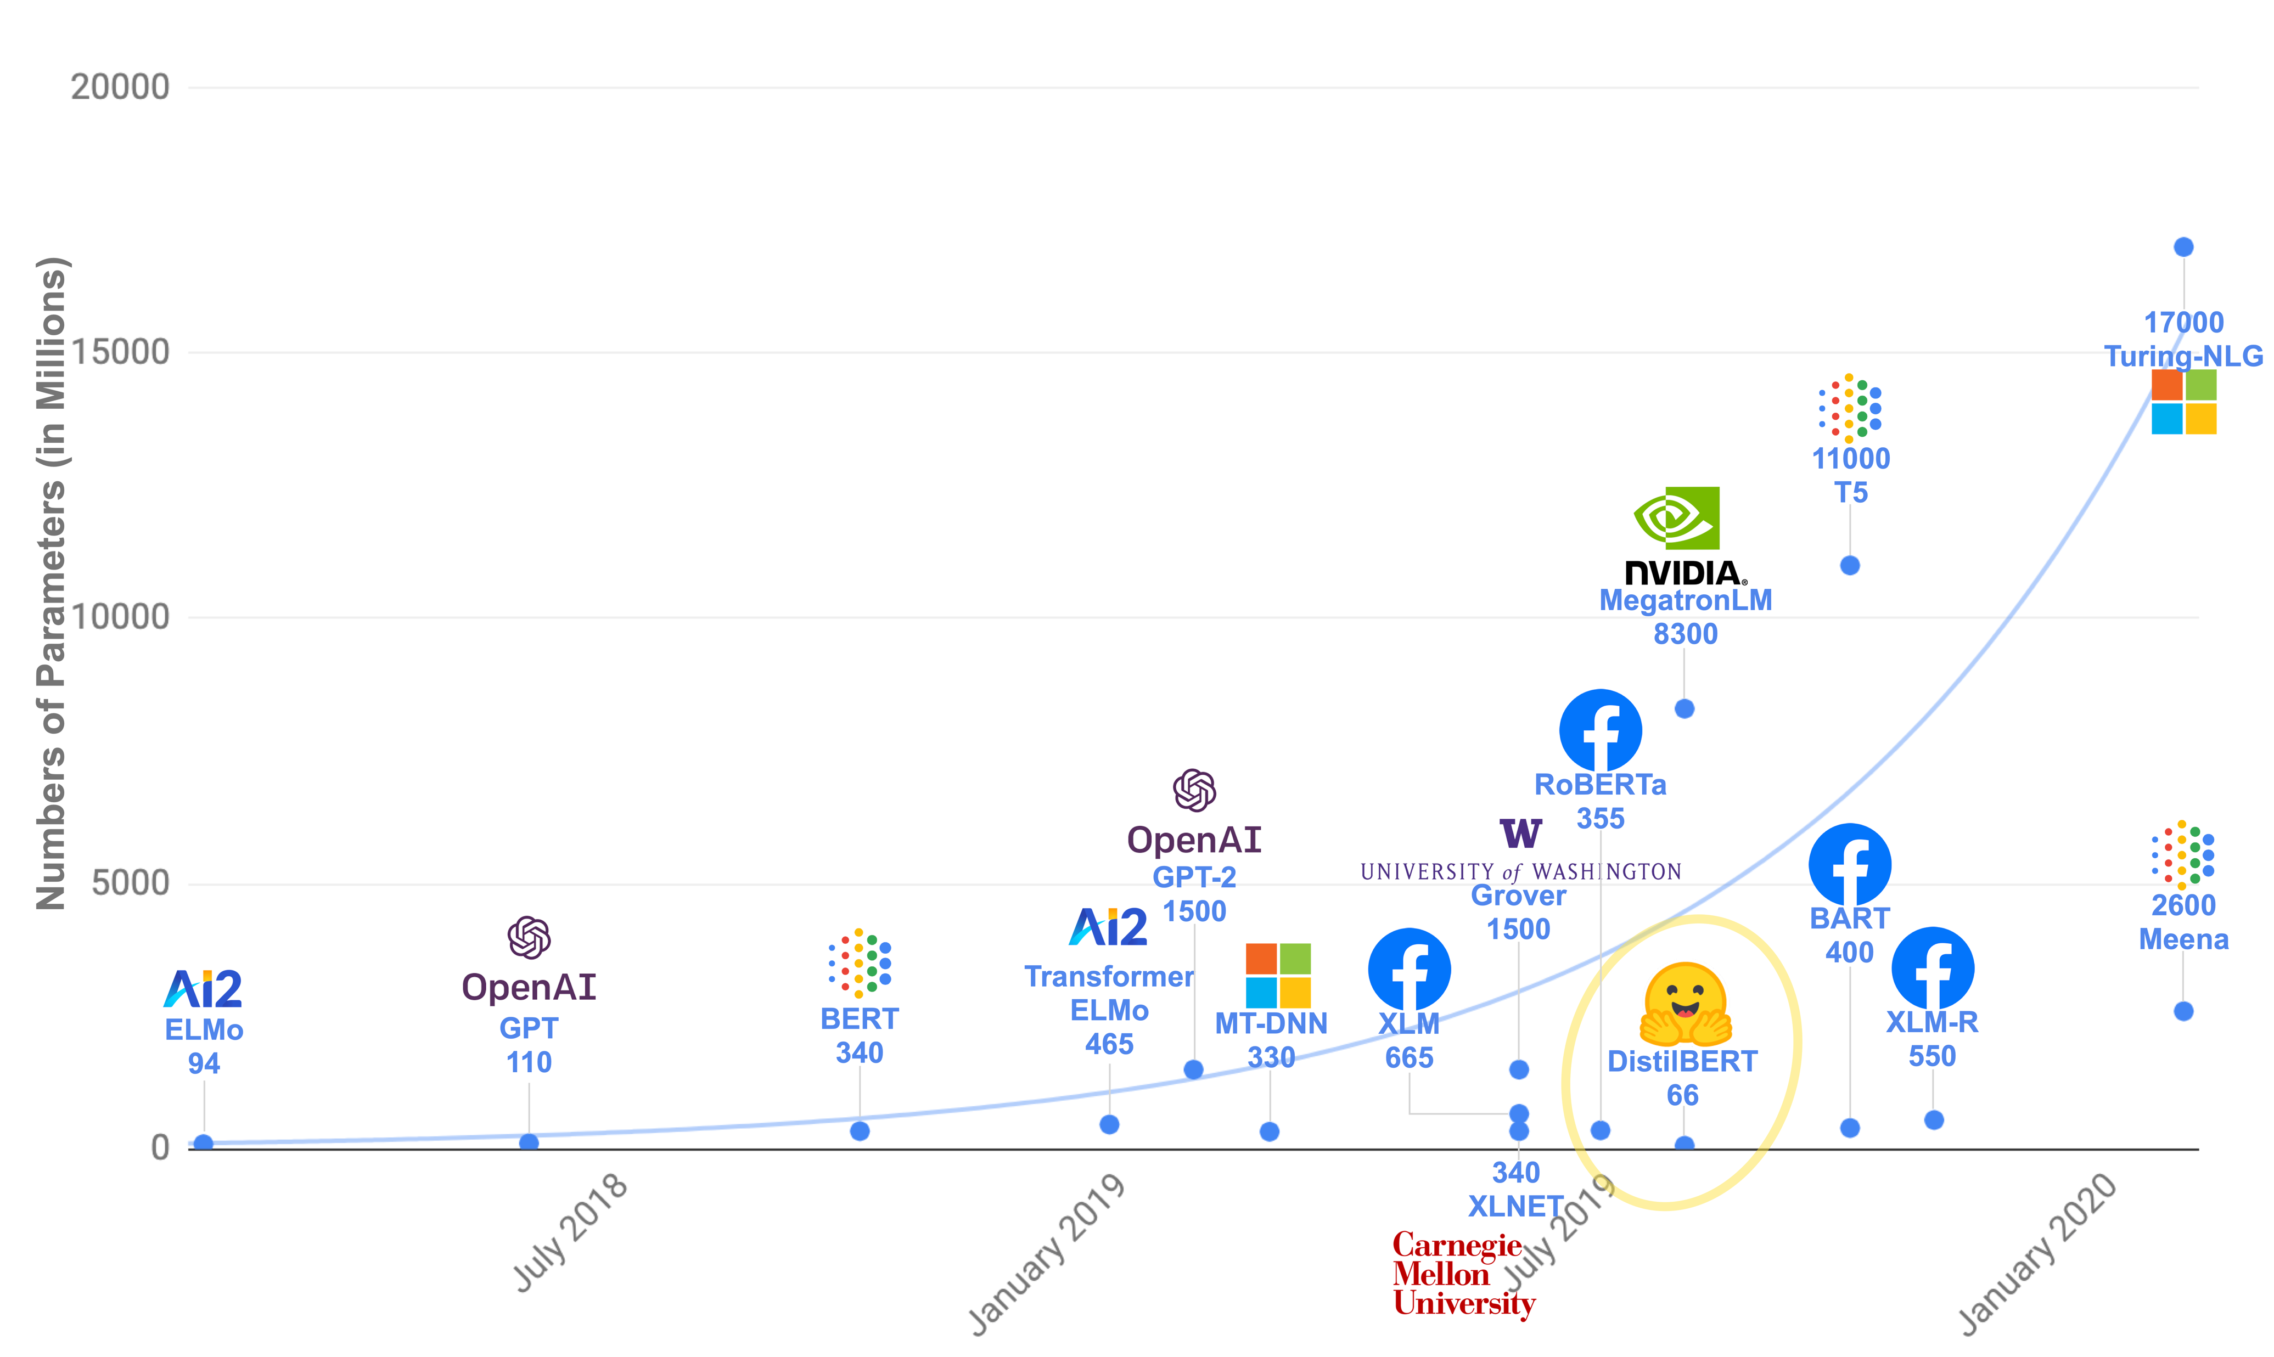
Model Parameters

Slide 21
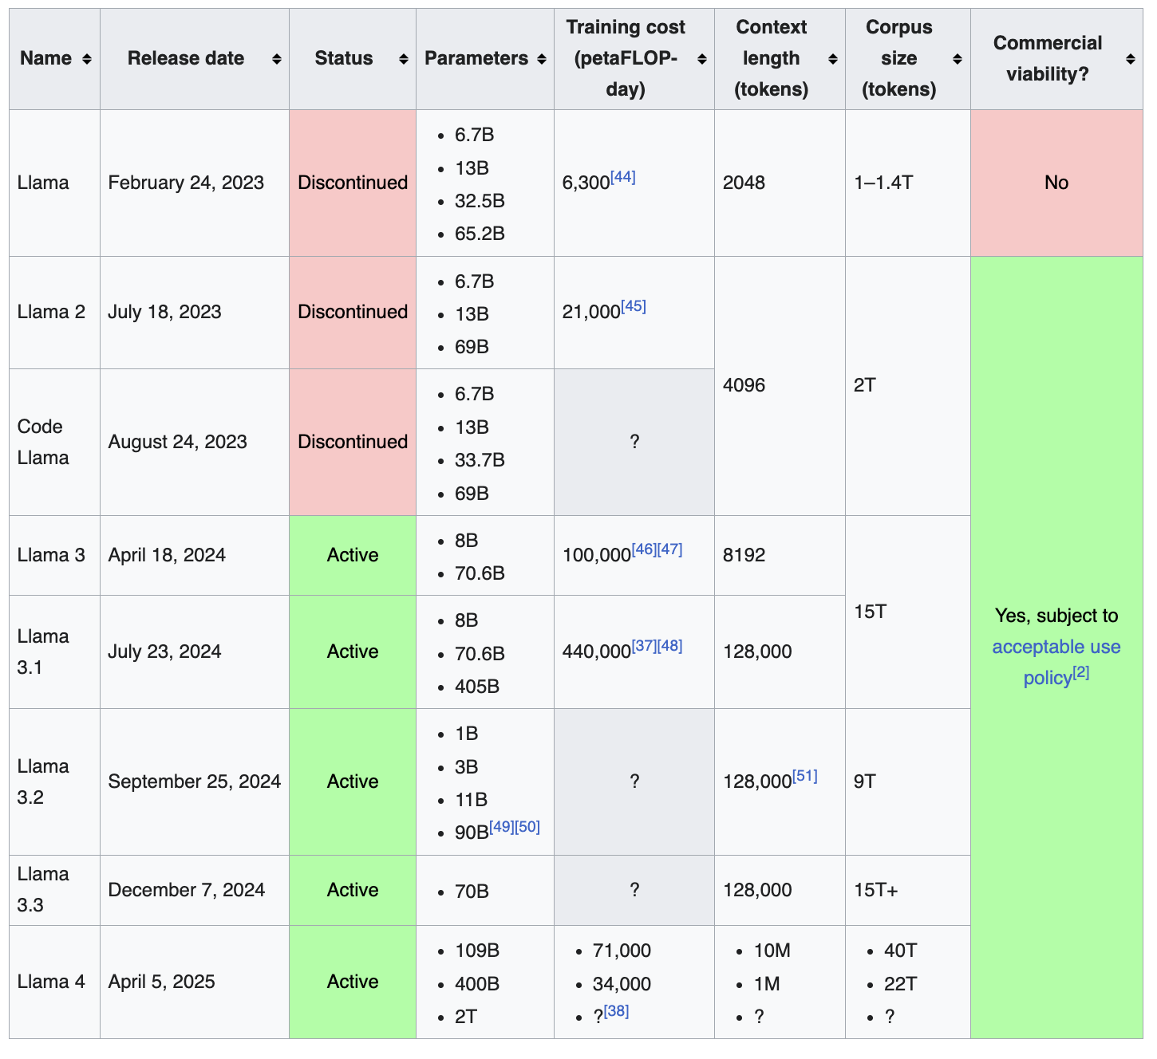
Model Parameters

Slide 22
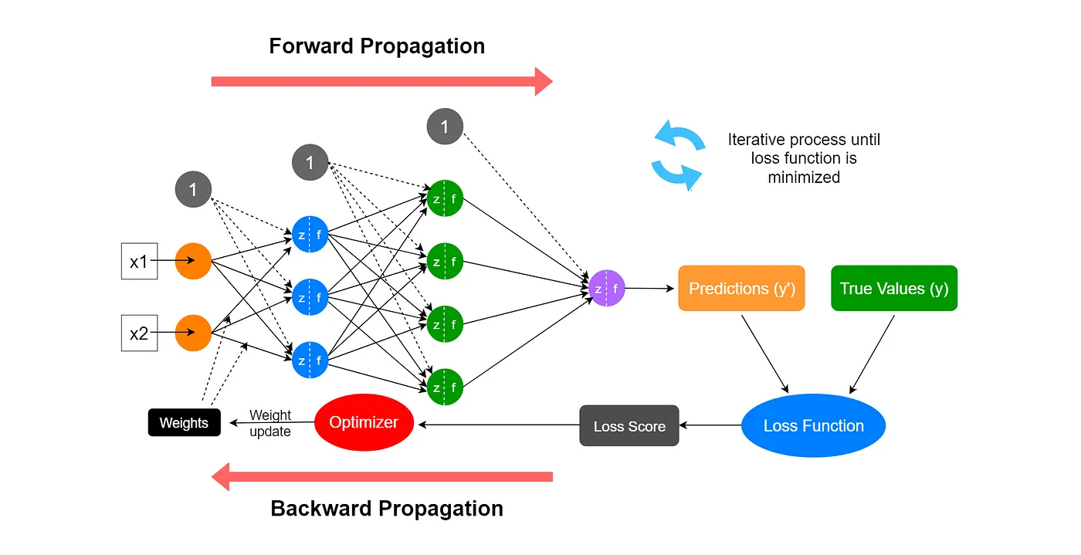
Training
Notes:
Input data goes forward through the network.
Each layer transforms the data (weighted sums, activations).
At the end, the network produces a prediction (Ŷ).
Example: image in → model → “Cat (0.9), Dog (0.1)”.
Analogy: like information flowing down a pipeline to reach a guess.
Compare & Loss
Prediction (Ŷ) is compared with the true label (Y).
Difference = loss → measure of error.
The loss tells us how wrong the model is, but not yet how to fix it.
Analogy: teacher marking the student’s answer (score = how far off).
Backpropagation (Learning Step)
The loss is sent backwards through the network.
Each weight gets feedback: “increase,” “decrease,” or “stay similar.”
Optimizer applies tiny adjustments to weights.
Analogy: student checking which step in their solution caused the mistake, then correcting it.
The Loop (Putting It Together)
One iteration = forward pass + loss + backpropagation (update).
Repeat many iterations (batches, epochs).
Over time → weights capture patterns in the data.
This cycle is the same for CNNs, ViTs, LLMs — only the architecture inside changes.

Slide 23


Slide 24
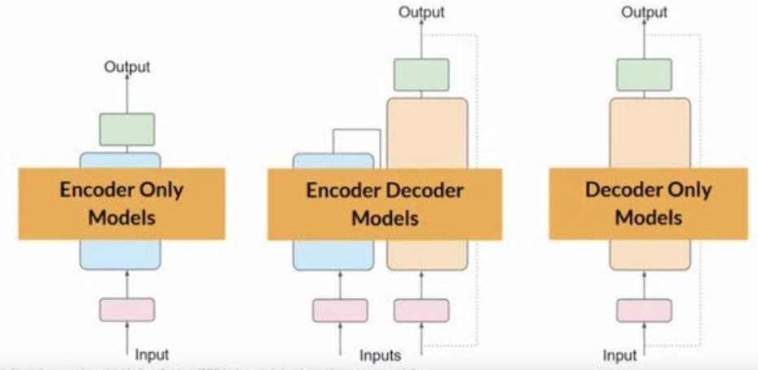
Modern neural architectures
Based on how data flows through the model.
Encoder-only
Decoder-only, and
Encoder–decoder.
Notes:
Now we know what makes a model heavy or light: the number of parameters (weights). But parameters alone don’t tell us how the model processes data.
To understand what a model actually does with those weights, we need to look at its architecture — the blueprint of how inputs are transformed into outputs.
At the highest level, modern neural architectures fall into three families: encoder-only, decoder-only, and encoder–decoder. These terms describe how data flows through the model.

Slide 25
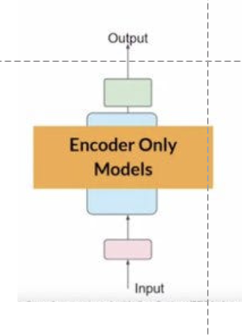
Encoder
A skilled note-taker → reads a whole book and produces a clear summary.
An encoder is the part of a model that reads the input and builds an internal summary (representation).
Think of it as a compressor: it takes raw messy data and turns it into a compact, meaningful code.
Examples:
BERT (text): turns sentences into embeddings used for classification or search.
ViT (vision): turns image patches into a feature vector for classification.
Good for: classification, clustering, feature extraction.

Slide 26
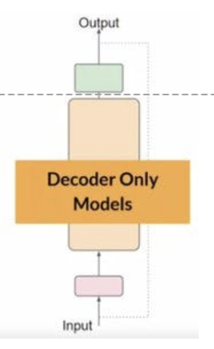
Decoder
A skilled storyteller → takes a summary and tells the full story in words
A decoder is the part of a model that generates new outputs from a representation.
It expands a compressed meaning back into a sequence (text, audio, image).
Examples:
GPT (text): generates next words one by one.
TTS models: generate audio waveforms from text.
Good for: translation, text generation, image captioning, TTS.

Slide 27
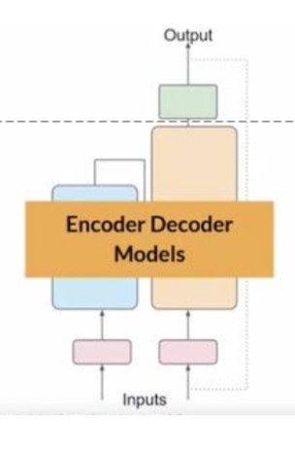
Encoder–Decoder Together
The seq2seq pipeline combines both:
Encoder compresses input (e.g. French sentence).
Decoder generates new sequence (English translation).
Examples:
Whisper (speech → text): audio in → encoder → text out via decoder.
Machine translation: one language in → encoder → another language out via decoder.

Slide 28
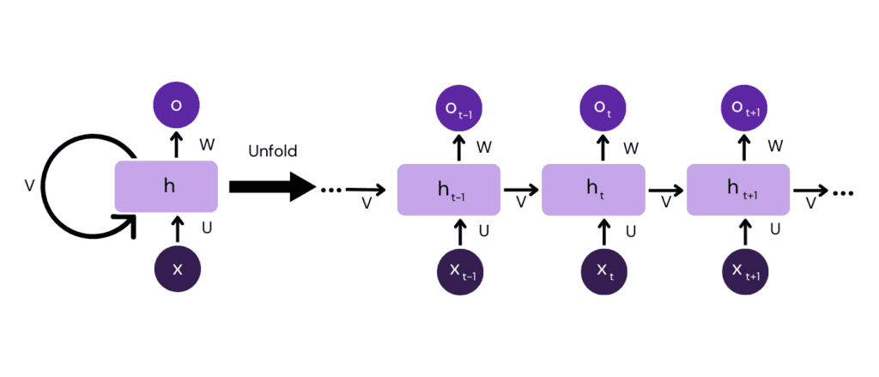
The Problem: Fixed Context
Old models (RNNs, CNNs):
Process step by step or locally.
Hard to capture long-range dependencies.
Example: In the sentence “The cat that chased the dog was tired”,
The word “was” should connect to “cat”, not “dog”.
Traditional models often miss this.
Notes:
Encoders and decoders are the building blocks. But what really made transformers powerful was a new idea: attention — a way for the model to focus on the most relevant parts of the input, instead of treating everything equally.

Slide 29
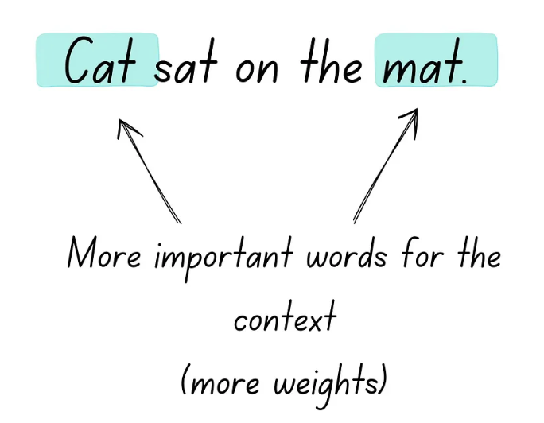
What is Attention? (Intuition)
Attention = focusing on the most relevant parts.
Analogy: when you read a sentence, you don’t remember every word equally → your brain focuses on the words that matter.
In ML: the model learns attention weights → which parts of the input should be emphasized for each prediction.

Slide 30
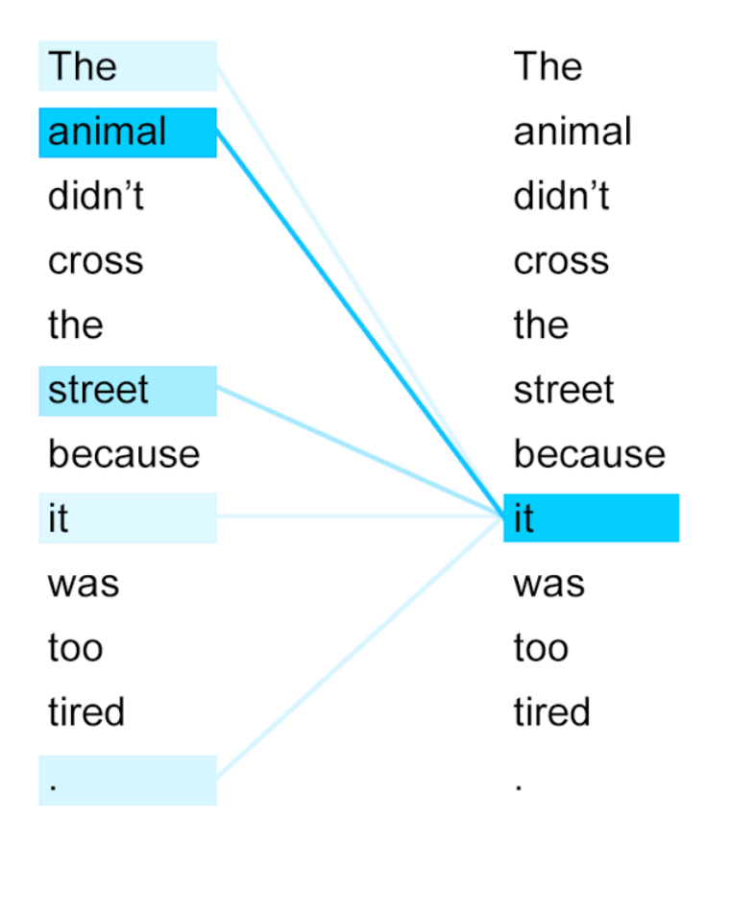
How Attention Works (High-Level)
Every token/patch compares itself with every other (similarity check).
Attention weights (numbers between 0 and 1) decide “how much should I care about this other part?”
Output = weighted combination of other tokens.
Every position can “look” at every other position directly.

Slide 31
Why Attention is Powerful
Handles long-range dependencies easily (any token ↔ any token).
Parallelizable (no step-by-step bottleneck like RNNs).
Universal: works for text, images (patches), audio (frames).
This is why transformers replaced RNNs/CNNs in many domains.

Slide 32
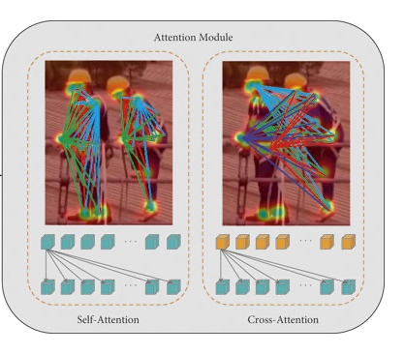
Self-Attention vs Cross-Attention
Self-attention:
Each token attends to other tokens in the same sequence.
Used in encoders (e.g., BERT, ViT).
Cross-attention:
Decoder attends to encoder outputs.
Used in encoder–decoder models (translation, Whisper, TTS).

Slide 33
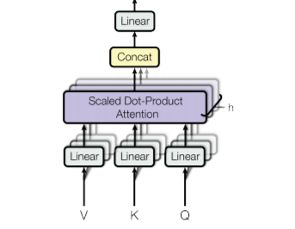
Multi-head attention
A single attention head can only focus in one way.
But language, vision, and audio have many kinds of relationships:
Syntax vs meaning.
Local vs global.
Fine detail vs broad theme.
Multi-head attention = multiple “lenses” in parallel.
Each head looks at the sequence differently.
The outputs are combined into a richer representation.

Slide 34
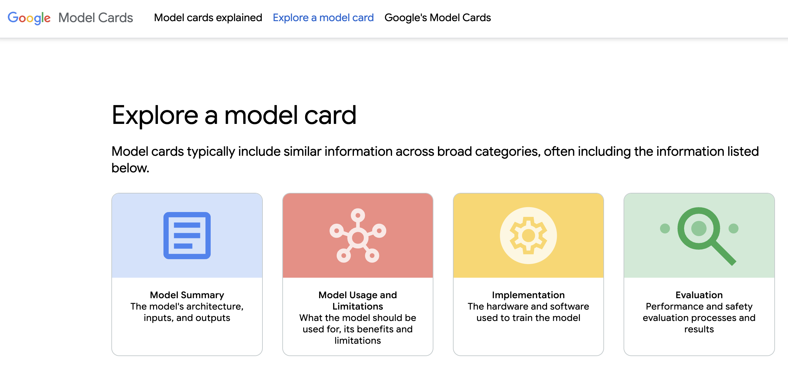
Model cards
https://modelcards.withgoogle.com/model-cards

Slide 35
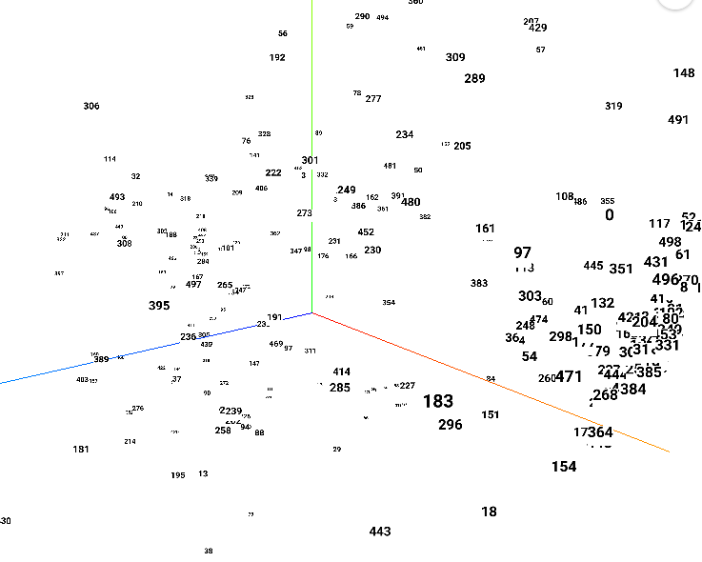
Embeddings
Models can’t work with words, pixels, or audio directly.
First step: turn data into numbers.
Those numbers are organized as embedding vectors.
Each embedding captures meaning, not just raw values.
“Cat” embedding ≠ ASCII code — it encodes meaning & context.

Slide 36
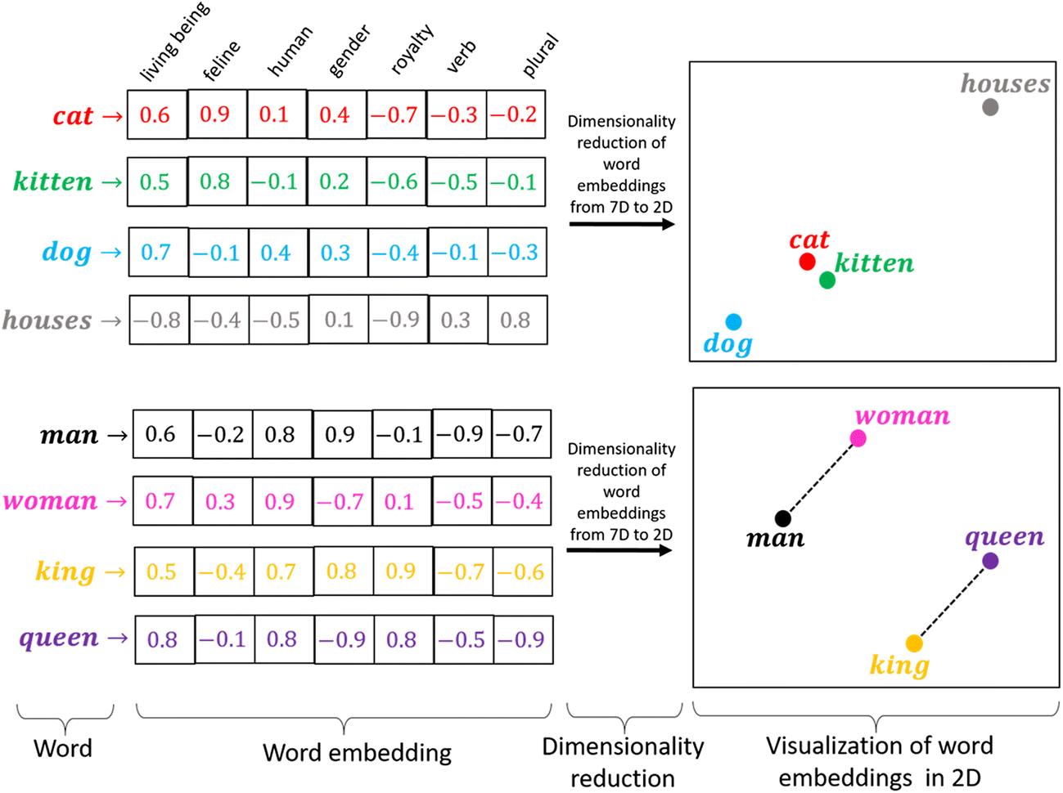
Embeddings

Slide 37
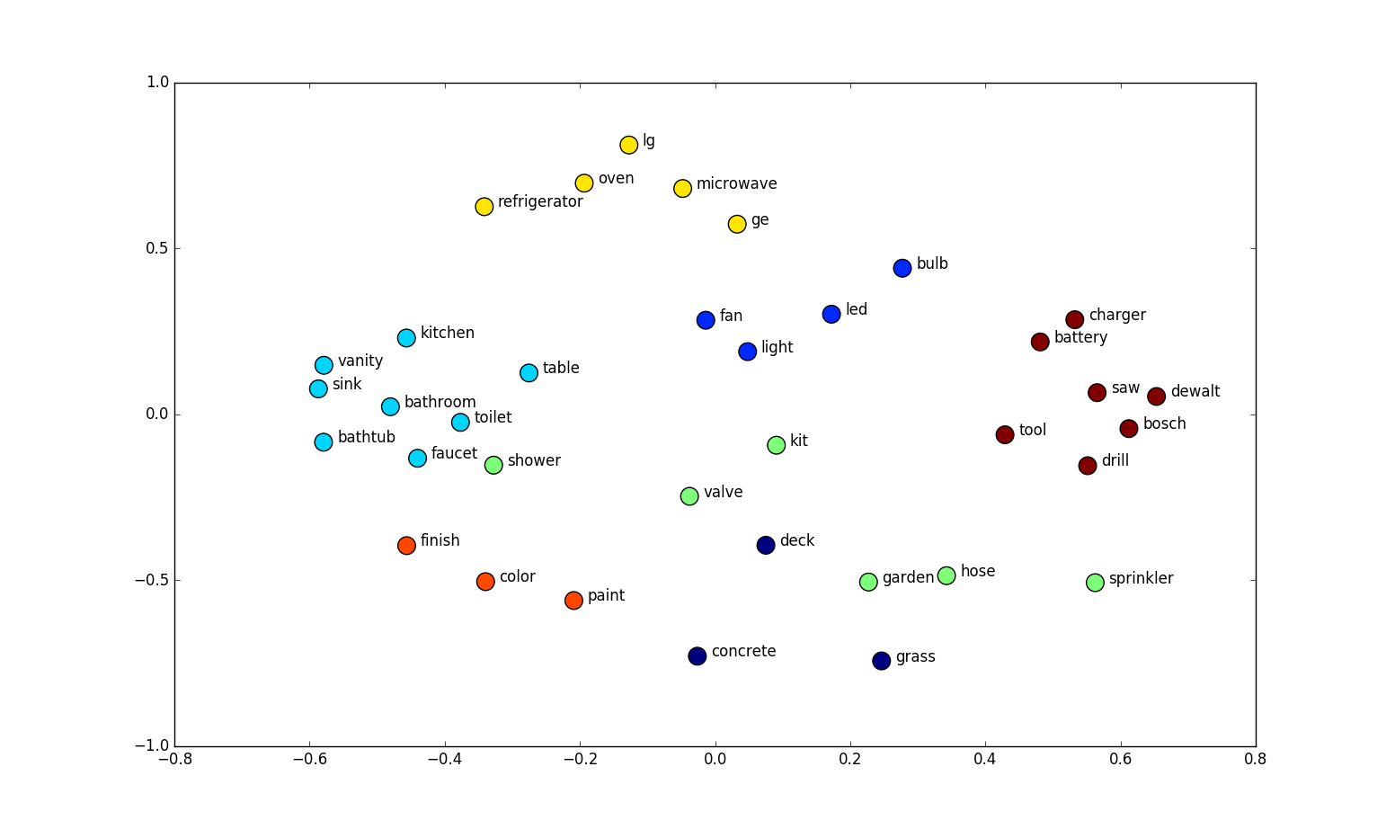
Embeddings as vectors

Slide 38
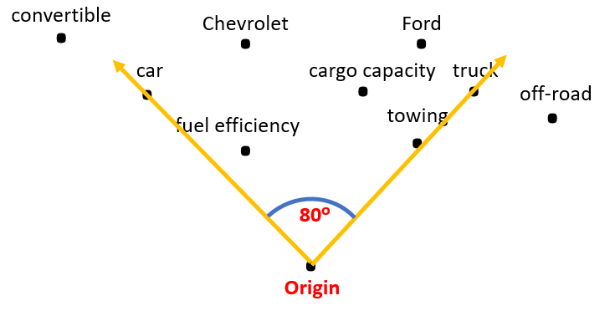
Embedding “closeness”
To compare two embeddings, we measure the angle between them.
Cosine similarity = cos(angle).
1 = identical direction (very similar).
0 = unrelated (90° apart).
–1 = opposite meaning (rare in embeddings).
Used in:
Semantic search (find closest match).
Clustering (group by similarity).
Recommenders (similar songs, products).

Slide 39
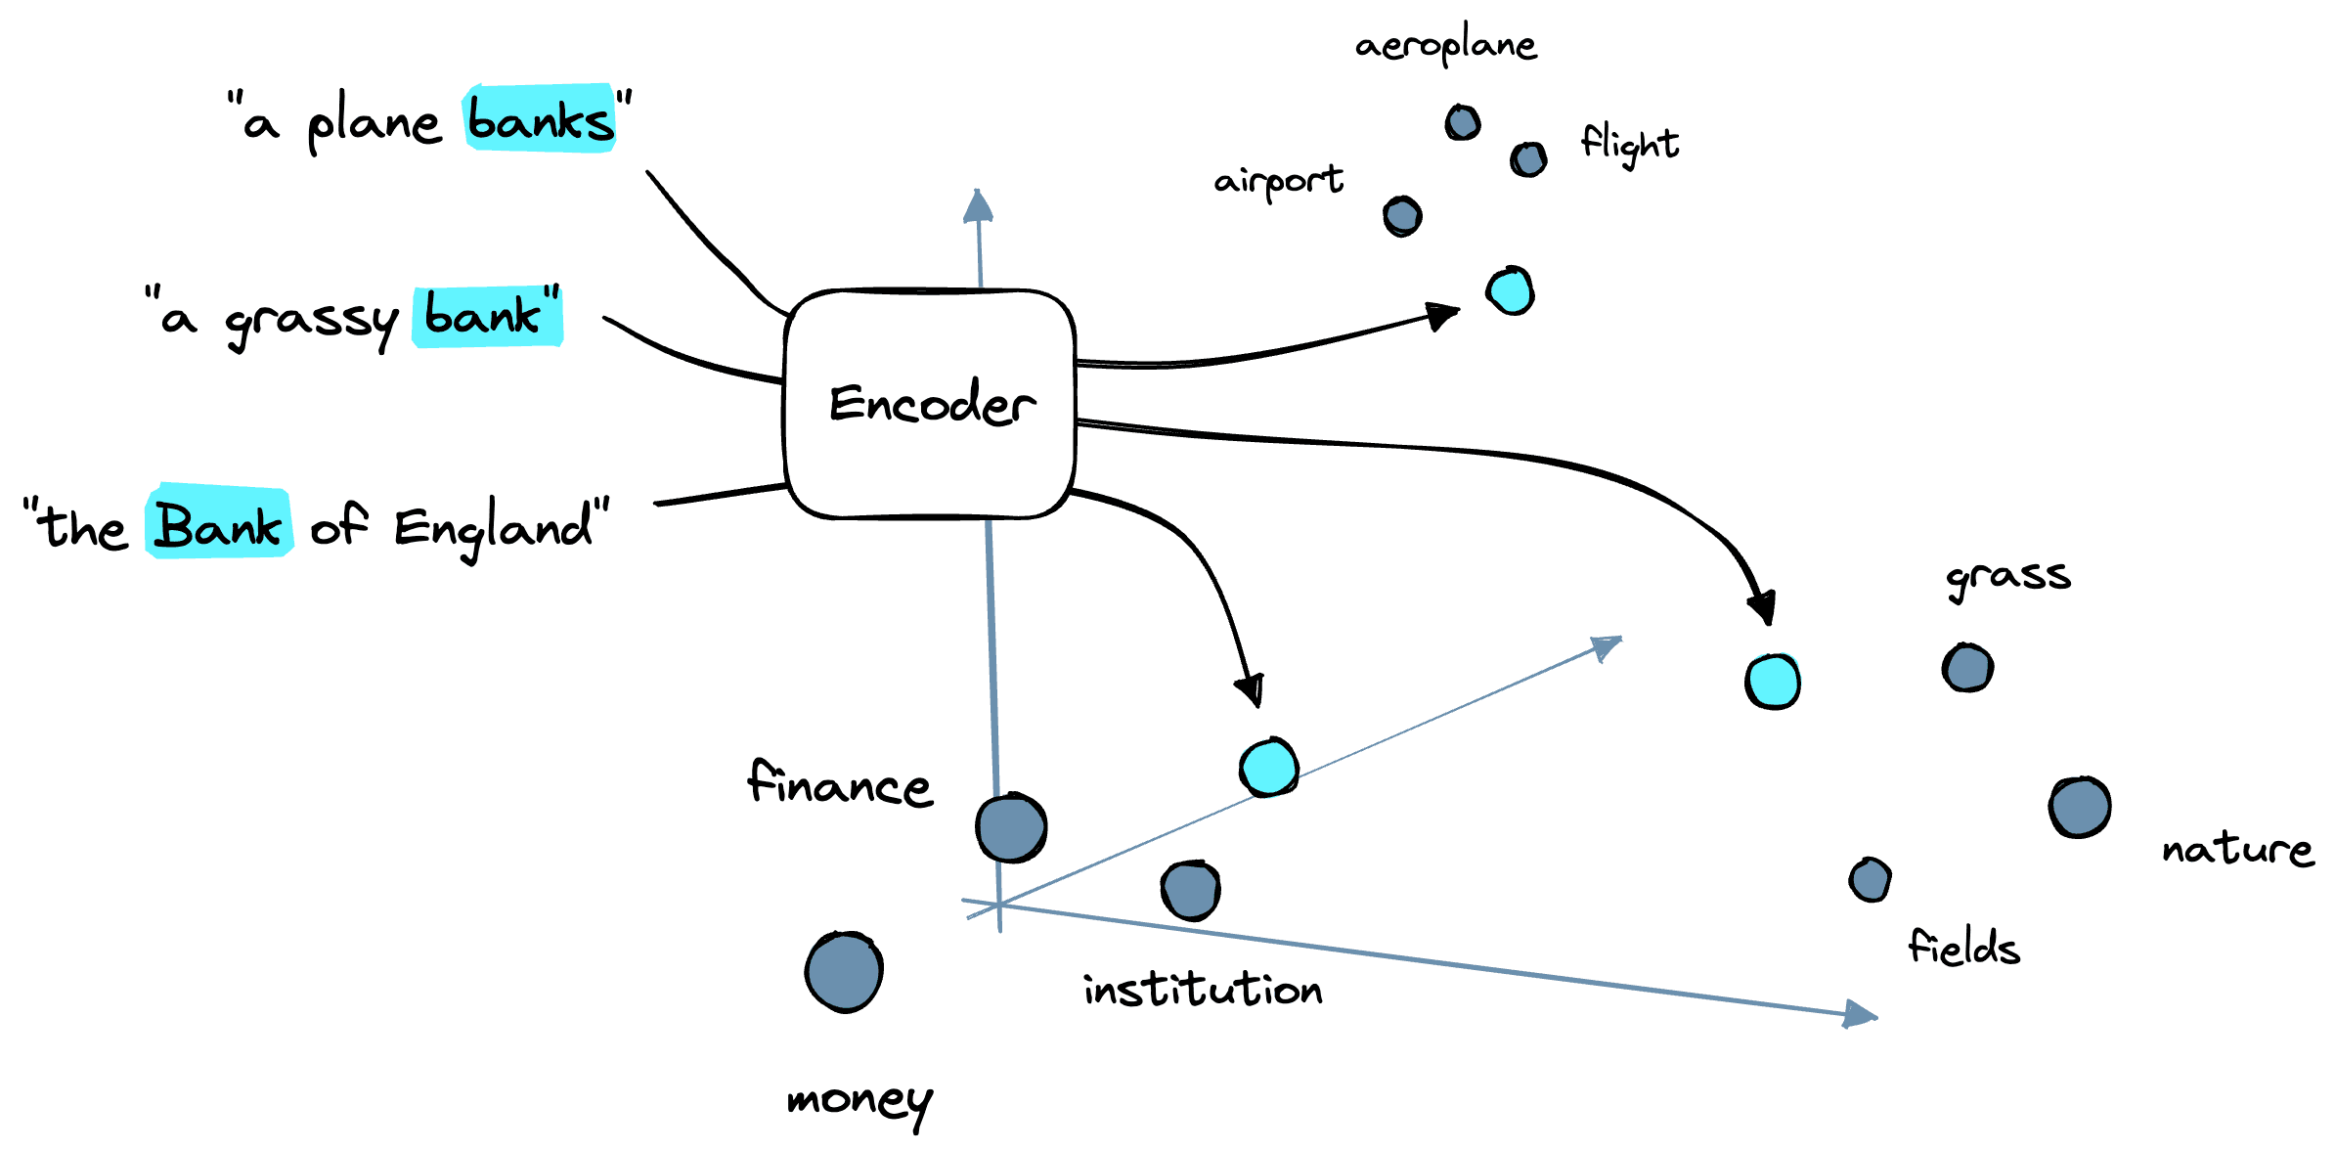
Embeddings are model inputs
Input to models: everything starts as embeddings.
Outputs from encoders: embeddings = compressed meaning, reused later.
Reusable features:
Search: find similar documents/images.
Classification: use embeddings to predict labels.
Clustering: group similar data without labels.
This is why model cards always mention embedding size (e.g. hidden_dim = 768).

Slide 40
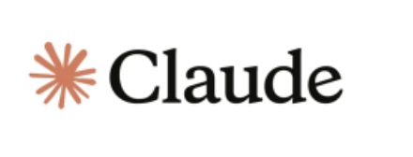

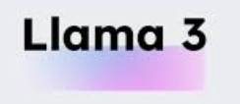
Types of models: open models vs proprietary
Type | What It Means | Examples | Pros | Cons
Open Models | Architecture & weights are public | BERT, ViT, Whisper, LLaMA, Stable Diffusion | Transparent, reproducible, customizable, community-driven | May require more setup & compute, no official support
Proprietary Models | Weights/code not fully public; API access only | GPT-4, Gemini, Claude, Copilot | Easy to use, high performance, hosted & supported | Closed weights = less transparency, limited customization, usage costs
Notes:
Open models = freedom + control; Proprietary models = convenience + performance.

Slide 41
Types of models: pre-trained (out-of-box) vs developed from scratch/adjusted
Type | What It Means | Examples | Pros | Cons
Pretrained (Out-of-the-Box) | Model trained on large generic data, used directly | BERT for text classification, ViT for images, Whisper for ASR | Fast to deploy, strong baseline performance | May not fit domain-specific needs
From Scratch | Train new model with random weights on your dataset | Custom CNN for medical images, custom ASR on rare dialect | Full control, tailored to unique data | Expensive, slow, needs lots of data & compute
Adjusted (Fine-Tuned / Adapted) | Start from pretrained, adjust weights with your data | Fine-tuned GPT on customer chats, Wav2Vec on call center data | Balance: cheaper than scratch, more accurate than vanilla pretrained | Still requires quality labeled data & compute

Slide 42
Inference: Local vs API based
Approach | Why / When to Use | Requirements / Costs | Examples
API-based | Quick setup, no hardware needed, access to proprietary models | Pay-per-use (tokens/requests), dependent on provider uptime, data leaves your environment | OpenAI GPT, Gemini, Claude APIs
Local inference | Full control, no data leaves your machine, can run open-source models | Strong hardware (GPUs, RAM), setup complexity, energy cost | LLaMA, Stable Diffusion, Whisper run locally

Slide 43

Bias in Models and data: what to consider
Where bias comes from:
Data bias → training data doesn’t reflect reality (e.g., mostly English text, mostly Western images).
Label bias → annotations reflect human assumptions/prejudices.
Algorithmic bias → model overfits patterns that reinforce existing imbalances.
Why it matters:
Predictions may be less accurate for underrepresented groups (e.g., speech recognition failing on certain accents).
Can reinforce stereotypes (e.g., occupation → gender associations).
Reduces fairness and trust in deployed systems.
Notes:
What to check:
Who collected the data?
What groups or scenarios are missing?
Are evaluation benchmarks balanced?
Is performance consistent across sub-groups?

Slide 44

Many models: make you choice
Dozens of models exist for the same task (ASR, translation, image classification…).
Each claims to be “state of the art.”
How to decide:
Leaderboards → compare models on shared benchmarks (ImageNet, GLUE, LibriSpeech).
Evaluation metrics → accuracy, F1, BLEU, WER, MOS (depending on task).
Other factors:
Compute cost (inference speed, GPU needs).
Licensing (can you use it commercially?).
Domain fit (general vs domain-specific training).

Slide 45
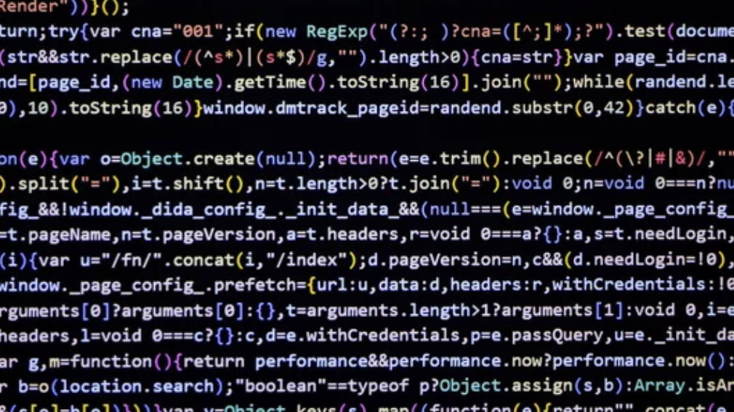
Let’s code

